Slide 1


Conditional Statements
NarendraP
Jq Command for Bash Shell Scripting

Slide 2
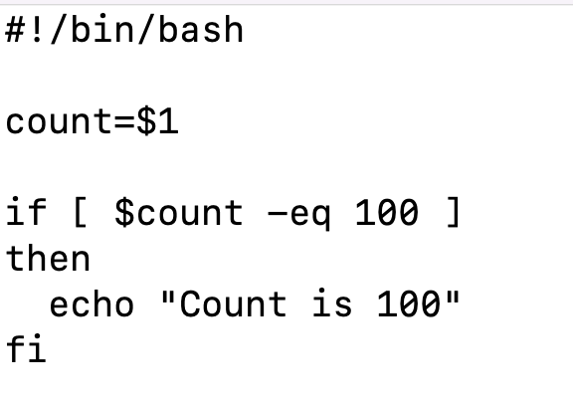
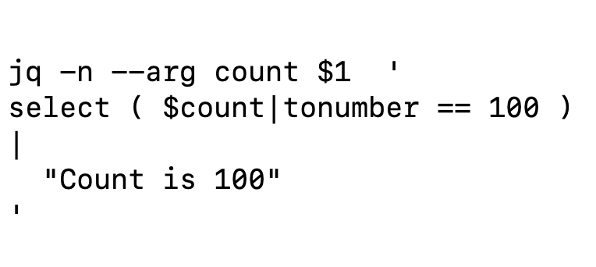
Conditional Statements:
Simple If Condition:
Jq is a command-line utility to parse JSON Data

Slide 3
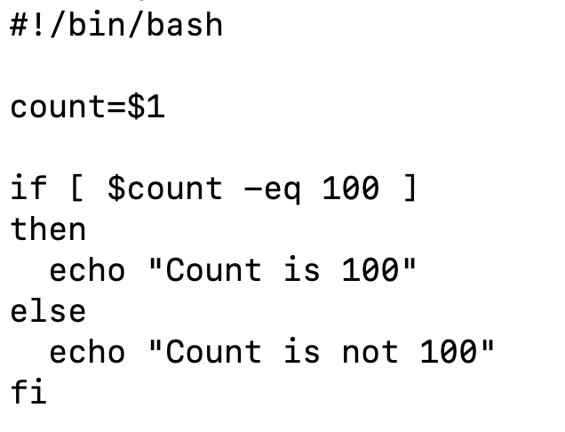
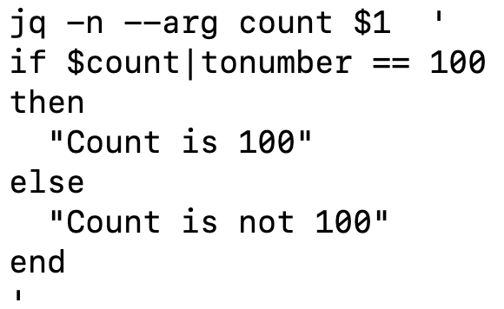
Conditional Statements:
If else Condition:
Jq is a command-line utility to parse JSON Data

Slide 4
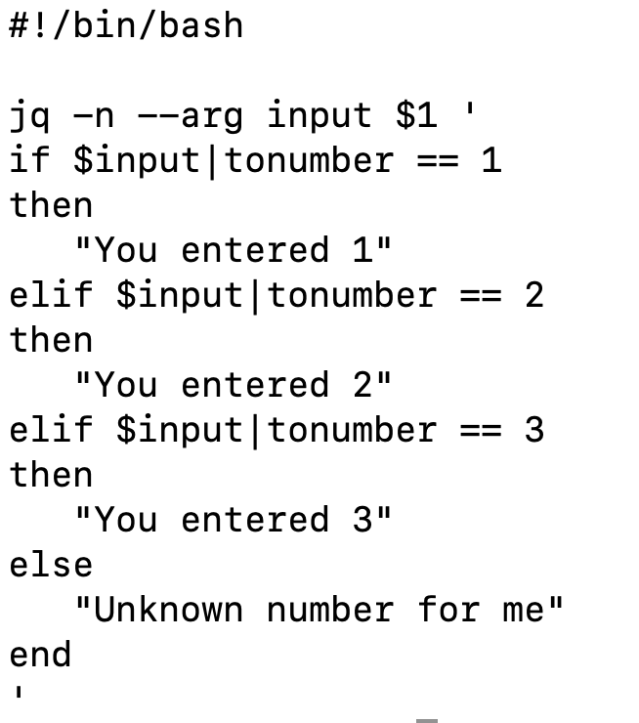
Conditional Statements:
If elif ….else:
Jq is a command-line utility to parse JSON Data

Slide 5
Thank you

